Slide 1
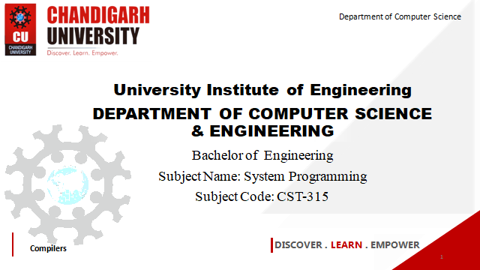

Department of Computer Science
University Institute of Engineering
DEPARTMENT OF COMPUTER SCIENCE & ENGINEERING
Bachelor of Engineering
Subject Name: System Programming
Subject Code: CST-281
Compilers
DISCOVER . LEARN . EMPOWER

Slide 2
Chapter-1.3 Macro
Department of computer Science
Macro & Macro Processor Introduction
Macro Definition & Call
Macro Expansion

Slide 3
What is Macro & Macro processor
Macro
A macro represents a commonly used group of statements in the source programming language
Macro Processor
• The macro processor replaces each macro instruction with the corresponding group of source language statement, this is called expanding macros
• The functions of a macro processor essentially involve the substitution of one group of characters or lines for another

Slide 4
Macro & expansion
The MACRO statement identifies the beginning of a macro definition
The symbol in the label field is the name of the instruction
• The entries in the operand field identify the parameter of the macro instruction • Each parameter begins with the character & • The MEND assembler directive marks the end of the macro definition
• A macro invocation statement gives the name of the macro instruction being invoked and the arguments to be used in expanding the macro
In order not to overload the example with "knowhow", the nested macro only introduces itself kindly with a suitable character string in ROM.

Slide 5
References
John J Donovan Systems Programming Ebook Wordpress (pdflife.one)
[PDF] Systems Programming and Operating Systems by Dhamdhere - Free Download PDF (dlscrib.com)

Slide 6
THANK YOU

